Slide 1

HTML SVG
Scalable Vector Graphics

Slide 2

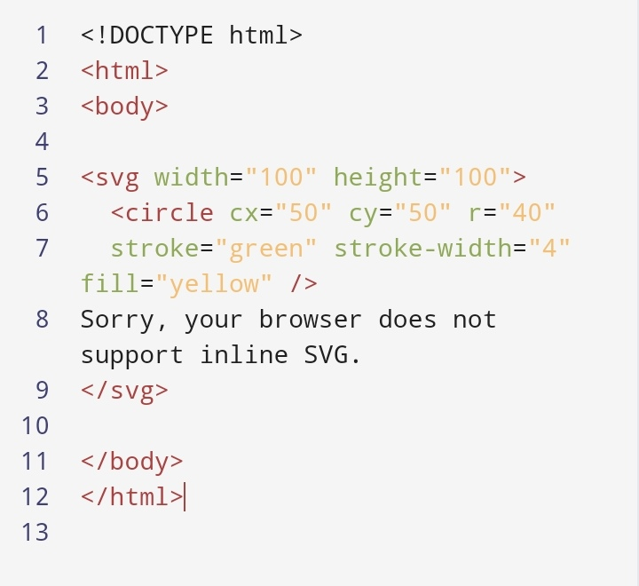


Slide 3
Thank you!!

